Slide 1
Artificial Intelligence for Games Week 7 – Agent Awareness Steve Rabin
For help on projects, email everyone (select and copy this string from the start of any class PowerPoint):
steve.rabin@gmail.com, p.jiankai@digipen.edu, b.hsu@digipen.edu, zak.s@digipen.edu, keaton.sullivan@digipen.edu, john.tseng@digipen.edu, a.roulst@digipen.edu
TAs: Jian Kai Phua, Brandon Hsu, Zak Stephenson, Keaton Sullivan, John Tseng, Andrew Roulst

Slide 2
Questions
What are some ways to determine statically during development that a spot on the terrain is dangerous.
What are some ways to determine dynamically at runtime that a spot on the terrain is dangerous.
Who came up with the Occupancy map technique and presented it at GDC 2009? Damian Island
What is the proper order for Occupancy map algorithm?
Normalize temp layer
Calculate each neighbor’s decay
Copy temp layer to influence layer
Linearly interpolate between old value and new value
Write value into the temp layer
Take max neighbor decay

Slide 3
Announcement: Linked In
Send me a link request!
Helps with networking
I have 1000+ links
I was congratulated as being in the top 1% of all viewed people
Out of 200 million

Slide 4
Research Project Proposals
Due on Wednesday July 3rd (worth 1%)
Teams of 3-4 students
Each student submits the identical proposal in Moodle
Directions
List team members
1 paragraph on what you will be researching and what you hope to achieve
1 paragraph on what your demo will consist of and show
1 paragraph on why this topic and your research is worthwhile to professional game developers. Please list examples of actual games that could benefit from this research.

Slide 5
Research Project Proposals
If you want a job in AI:
Pick an architecture (Planning, Hybrid)
Pick nav mesh generation/path smoothing
Other ideas:
Goal Bounding on a Nav Mesh
Procedural Content Generation (PCG)
Very interesting (but bad for job prospects):
Genetic algorithms or neural nets
No flocking or fuzzy logic projects
Look on aiwisdom.com or gameaipro.com for ideas
Use any base code you want
Class base code
Current or previous game projects
Unity or Unreal

Slide 6
Game Agents

Slide 7
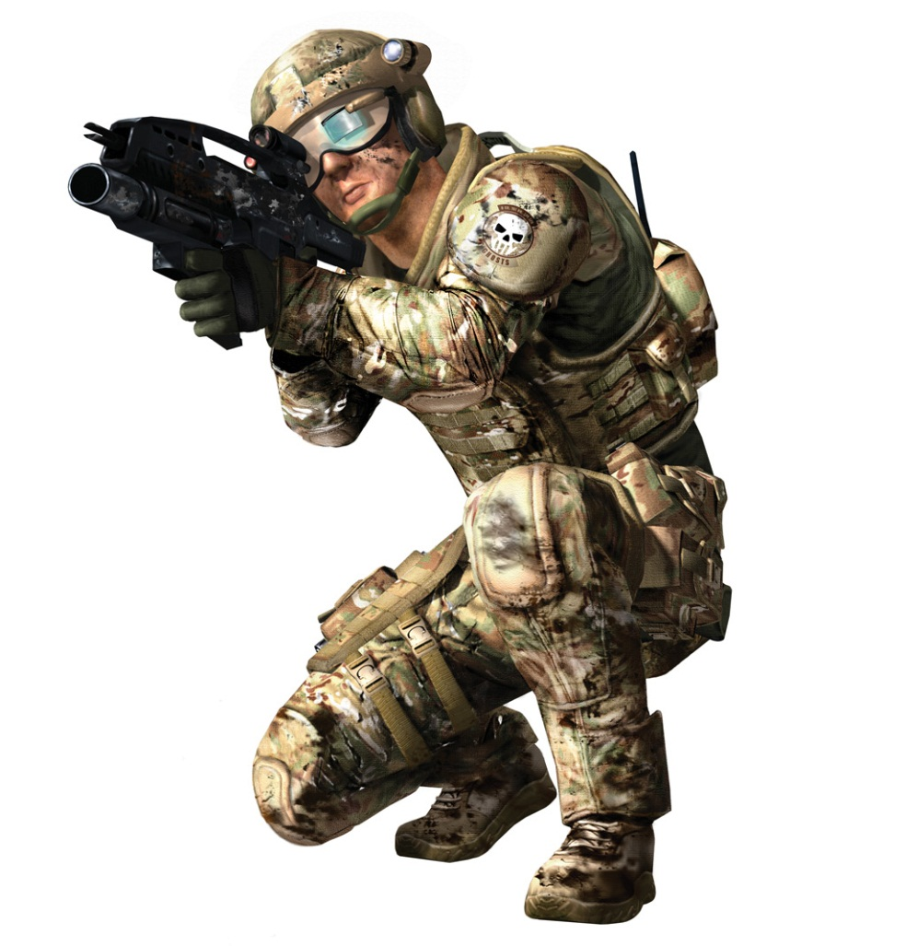
Game Agents
Continually loops through the
Sense-Think-Act cycle
Notes:
STA – cycle , see the world and do stuff with info gathered

Slide 8
Sense – Think – Act
Agent has access to perfect information of the game world
May be expensive/difficult to tease out useful info
Game World Information
Complete terrain layout
Location and state of every game object
Location and state of player
But isn’t this cheating???

Slide 9
Sense – Think – Act
Human limitations?
Limitations such as
Not knowing about unexplored areas
Not seeing through walls
Not knowing location or state of player
Can only know about things seen, heard, or told about
Must create a sensing model

Slide 10
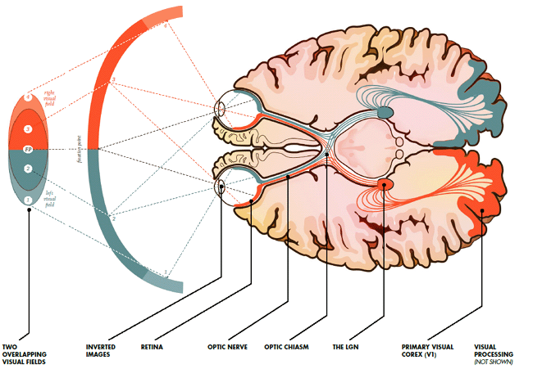
[Human] Agent Vision Model
How should we
model agent vision?
Notes:
Line of sight(3rd to check)
FOV test(2nd)
Distance/radius check(Cheapest is always go first )

Slide 11
[Human] Agent Vision Model
Get a list of all objects or agents; for each:
Is it within the viewing distance of the agent?
Is it within the viewing angle of the agent?
Is it unobscured by the environment?
What does the code look like?

Slide 12
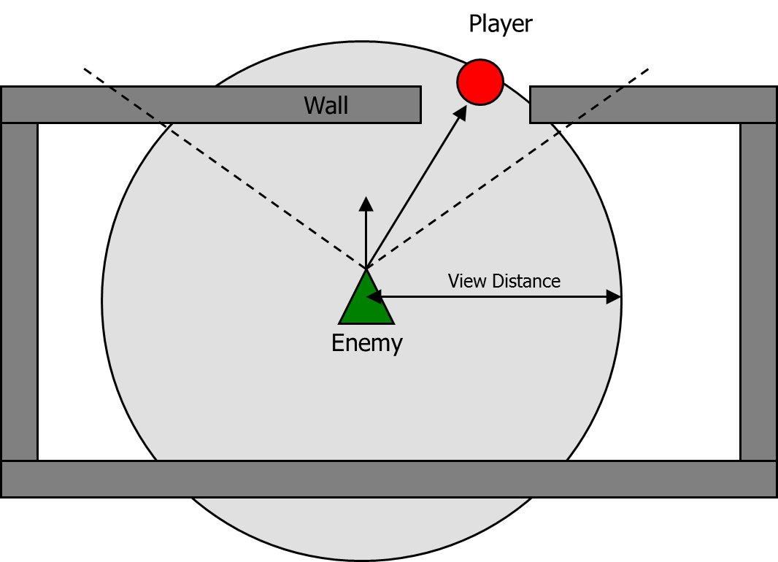

Slide 13
Viewing Angle
60°
90°
120°
180°

Slide 14
Viewing Angle
Dot Product
60°
0.866
90°
0.707
120°
0.5
180°
0.0

Slide 15
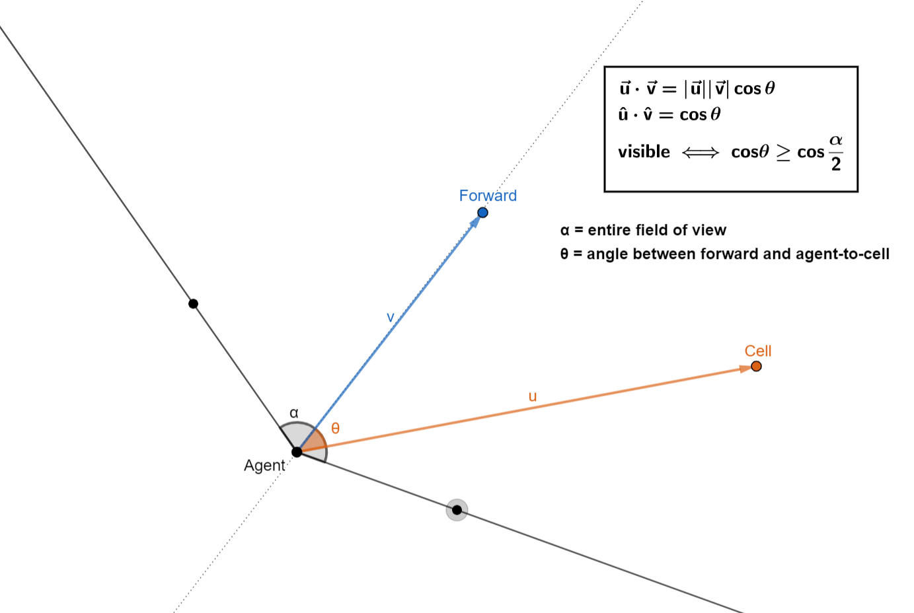

Slide 16
Obscured by the Environment
One ray cast?
Many ray casts?
How would you do it perfectly?

Slide 17
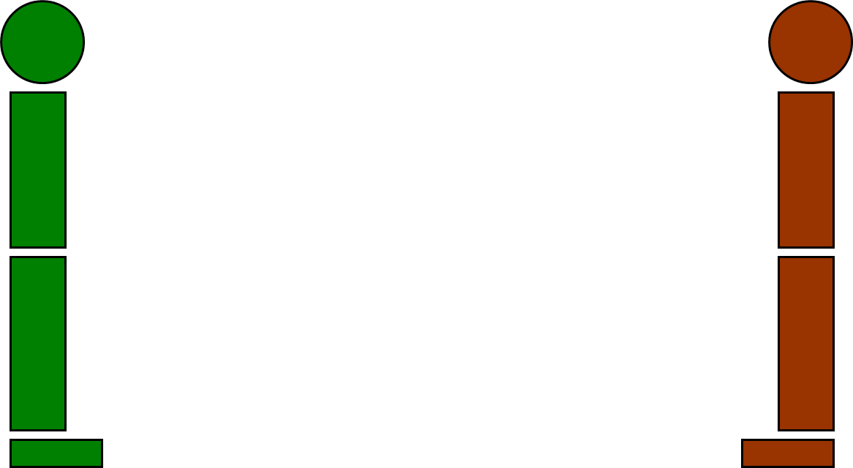

Slide 18
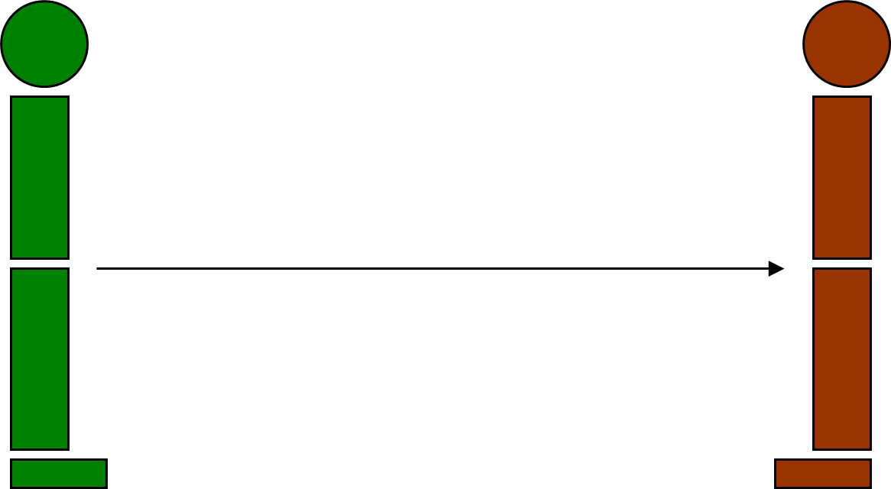
Notes:
Plevix area

Slide 19
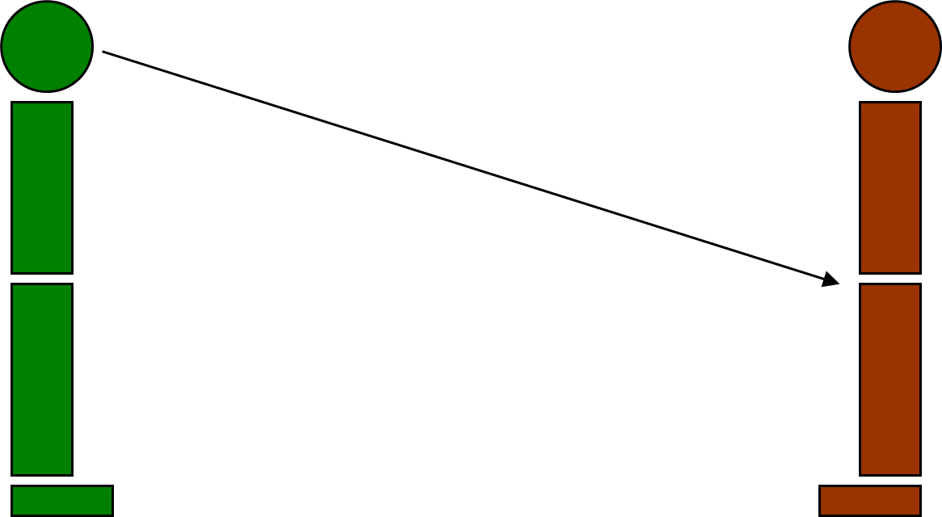

Slide 20
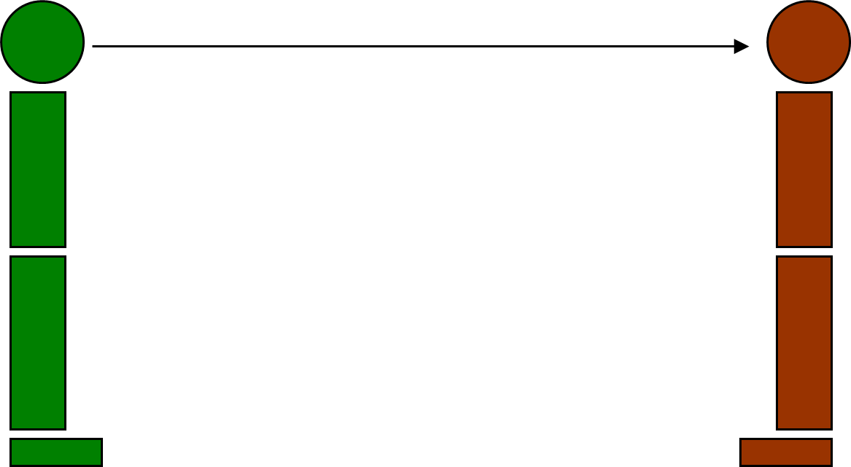
Notes:
Head ray pretty good spot If you can have only 1 ray

Slide 21
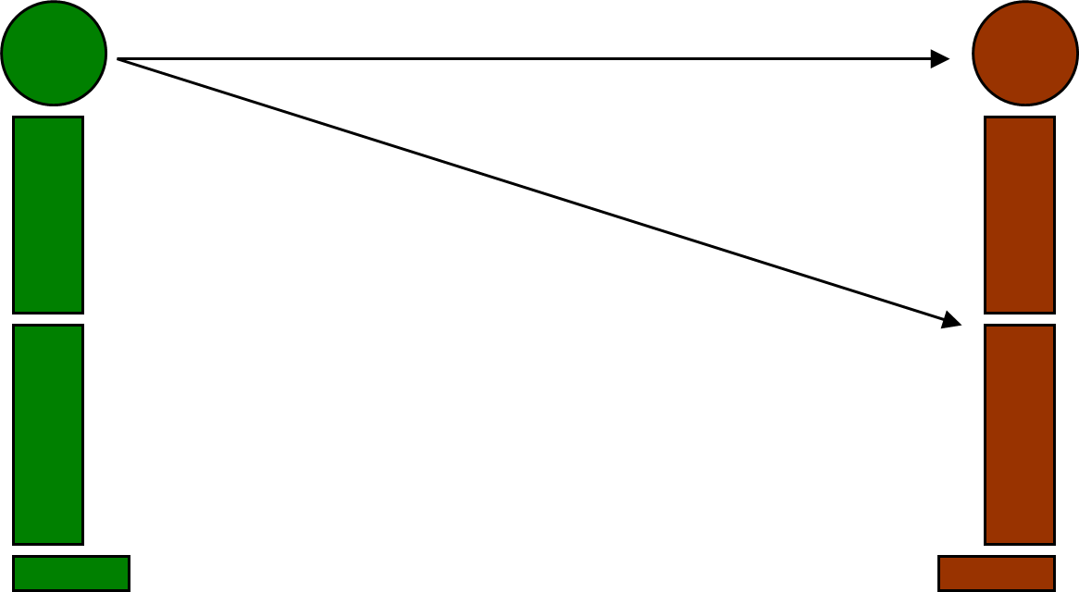

Slide 22
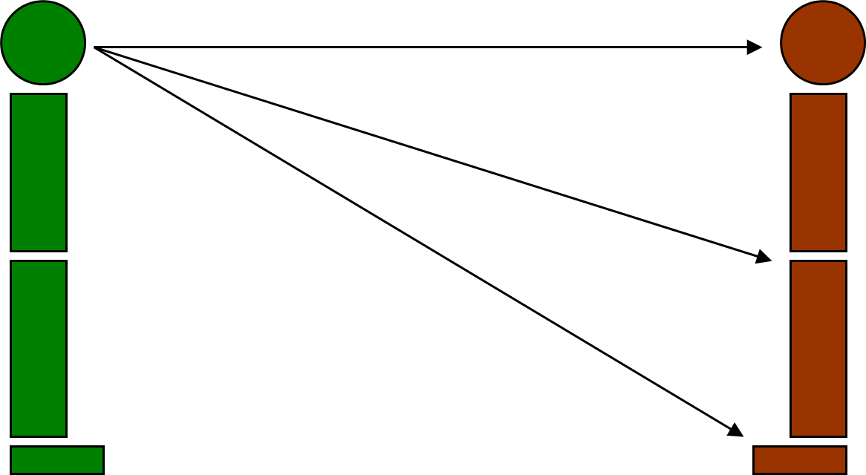

Slide 23
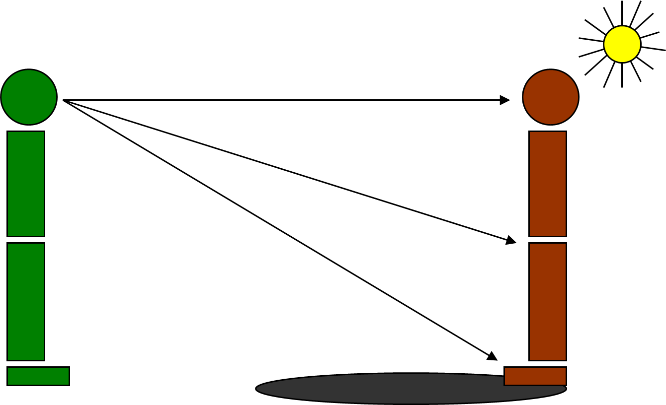

Slide 24


Slide 25
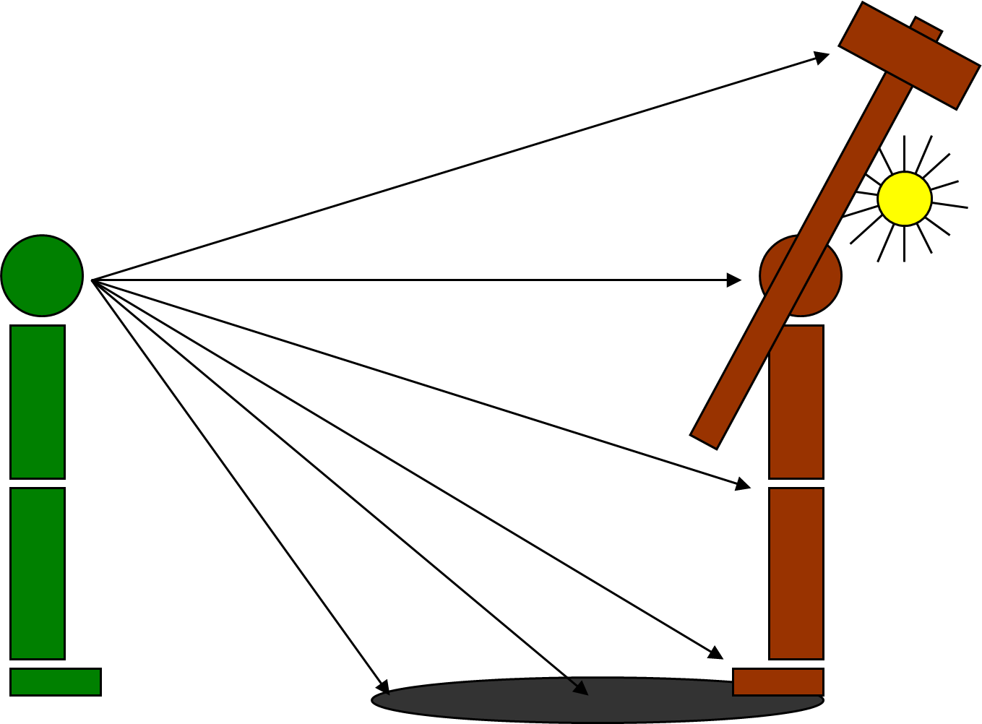

Slide 26
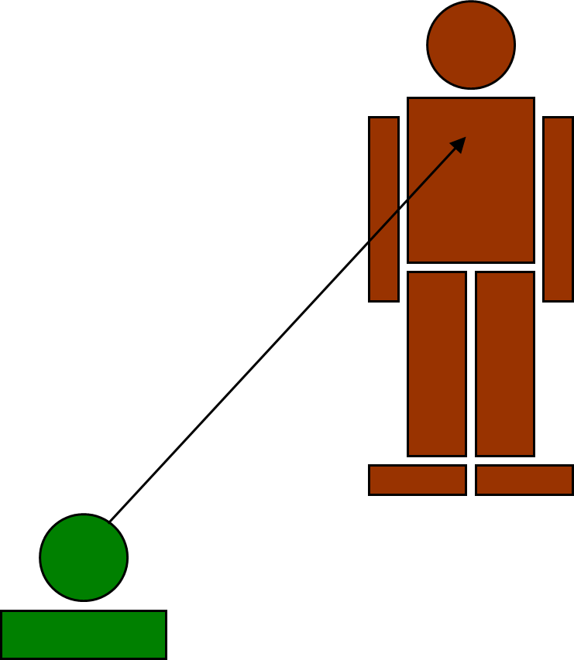

Slide 27
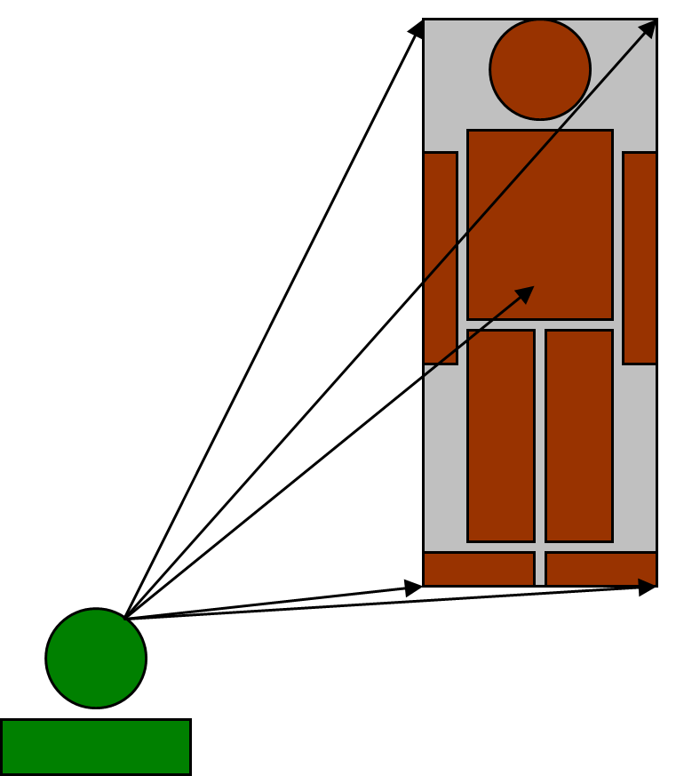

Slide 28
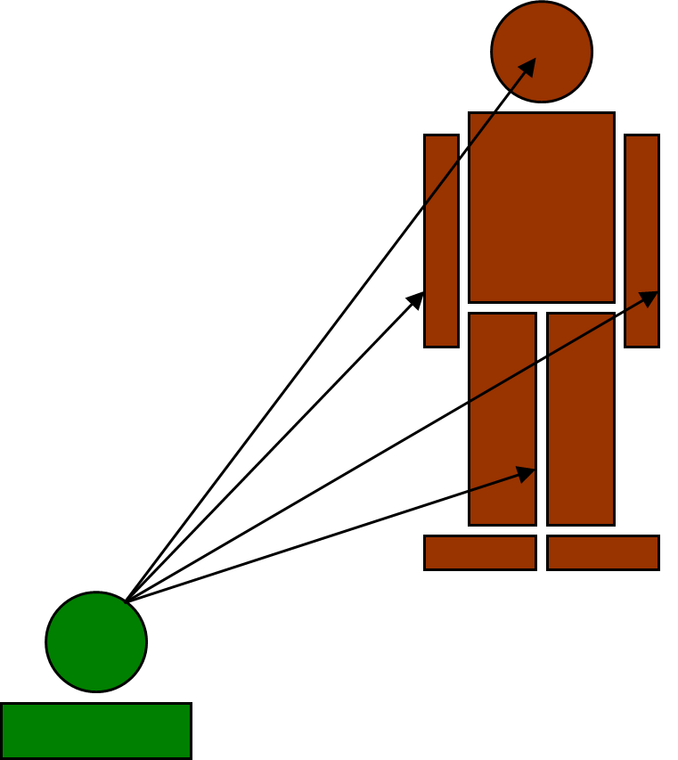

Slide 29
Splinter Cell Vision When Standing
Notes:
Above the head cause it’s the extreme height of the body

Slide 30
Splinter Cell Vision When Crouched
Notes:
Add at chest to encourage player to crouched often and be sneaky

Slide 31
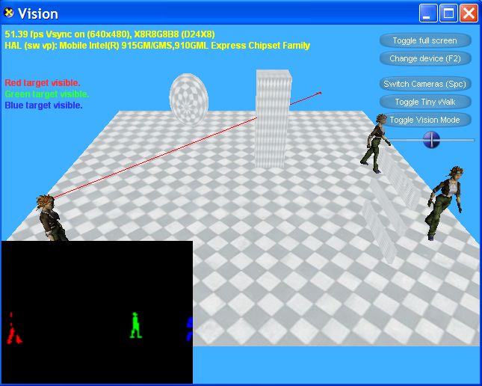
Research Project

Slide 32
[Human] Agent Vision Model
Get a list of all objects or agents; for each:
Is it within the viewing distance of the agent?
Is it within the viewing angle of the agent?
Is it unobscured by the environment?

Slide 33
Let’s Get More Real
Hard to see camouflaged objects
Hard to see non-moving characters
Hard to identify peripheral objects
Hard to identify far away objects

Slide 34
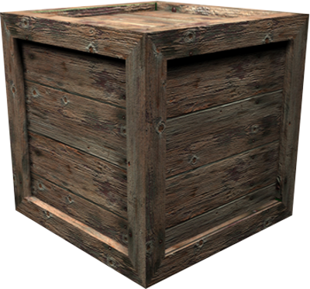
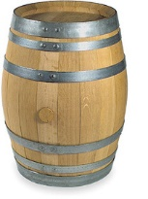
Hide and Shoot Algorithm
Autodesk Kynapse Demonstration
https://www.youtube.com/watch?v=reGq7G58T1Y

Slide 35
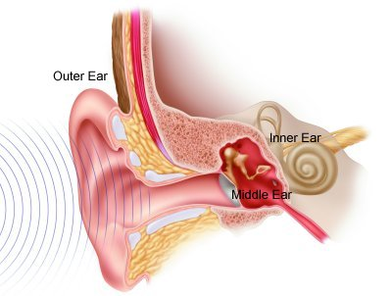
Human Hearing
Can recognize sounds
Knows what emits each sound
Can sense volume
Indicates distance of sound
Can sense pitch
Sounds muffled through walls have more bass
Can sense location
Where sound is coming from

Slide 36
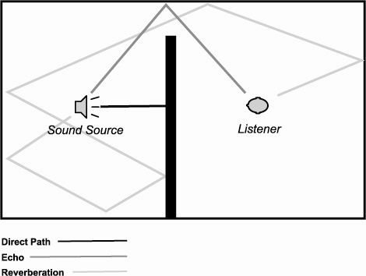
Modeling Hearing
How should an agent know about sounds?
Reflect off every surface?
How do you model hearing efficiently?

Slide 37
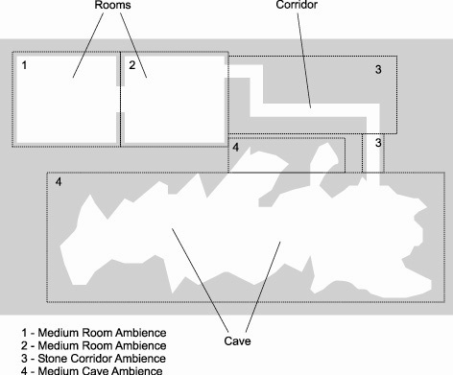
Efficient Hearing Model
Event-based
Distance
Zones

Slide 38

Agent Communication
Agents might talk amongst themselves!
Guards might alert other guards
Agents witness player location and spread the word
Model sensed knowledge through communication
Event-driven when agents close to each other

Slide 39
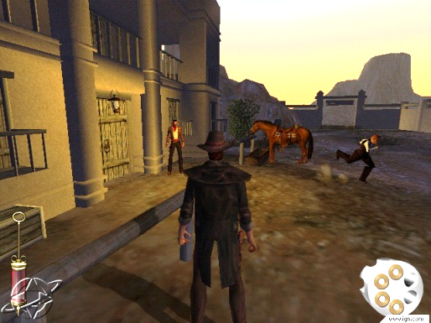
Reputations in Gunslinger (PS2)

Slide 40
Reputation Event
Subject Group | Player
Verb | DidViolenceTo
Object Group | Bandit
Object Individual | Joe
Magnitude | 75 (Killed)
Where | 50, 20, 138 (In front of Saloon)
When | High noon
Template | KilledBanditTemplate
Reference Count | Known by 11 NPCs
Reputation Effects | Bandits hate player more. Lawmen like player more. Farmers like player more.

Slide 41
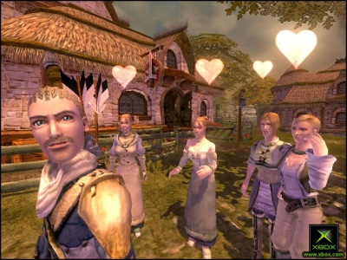
Player Reputation in Fable
Hero Stats: 5 opinion values in range [-1,1]
Morality [Evil, Good]
Renown [Contemptible, Renowned]
Scariness [Ridiculous, Scary]
Agreeableness [Offensive, Agreeable]
Attractiveness [Ugly, Attractive]

Slide 42
Player Reputation in Fable
5 global opinion values are Hero Stats
Each NPC has a Relative Opinion
Only directly witnessed acts or overheard acts
Absolute opinion = Hero Stats + Relative Opinion

Slide 43
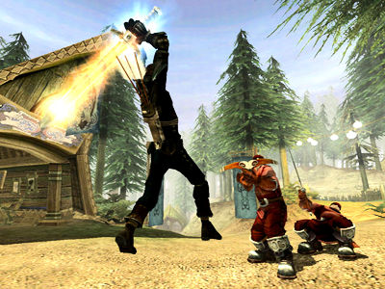
Fable’s Event-Driven Opinion Deeds
DEED_CRIME_WEAPON_OUT
DEED_CRIME_VANDALISM
DEED_EXPRESSION_HEROIC_STANCE
DEED_EXPRESSION_FLIRT
DEED_RECEIVE_GIFT_ROMANTIC
DEED_RECEIVE_GIFT_FRIENDLY

Slide 44
Simplest AI Trick in the Book Steve Rabin Principal Lecturer DigiPen Institute of Technology

Slide 45
Agent Reaction Time

Slide 46
Agent Reaction Time
AI sees the player…
How long before the AI reacts?
Somewhere between 0 and 1 seconds…
Quarter of a second? Half a second?

Slide 47
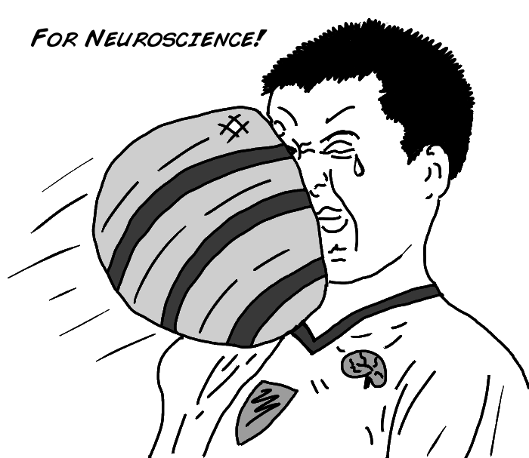

Slide 48

Simple Reaction Time

Slide 49
Simple Reaction Time
0.2 seconds

Slide 50
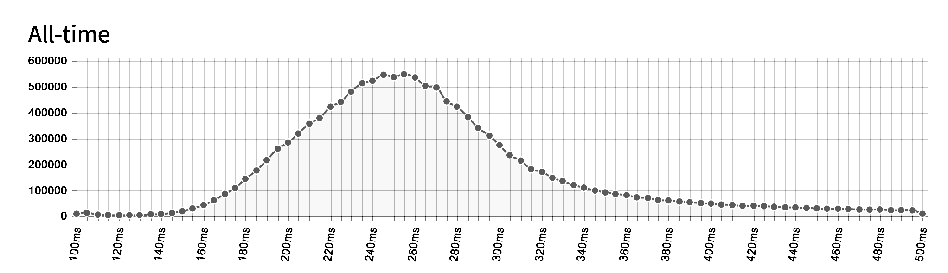
14,736,176 clicks 0.250s median reaction time http://www.humanbenchmark.com/

Slide 51
Go / No Go Reaction Time

Slide 52
Go / No Go Reaction Time
0.4 seconds

Slide 53
It’s always worse…
Add more time for:
Distracted
Hard to identify stimuli
Complex reaction action

Slide 54
Agent Cooperation

Slide 55
Agent Cooperation
How might agents cooperate?
With one other NPC?
In a mob “kung-fu” style?
In a squad?
On a baseball team?
As part of a 5000 person invasion?

Slide 56
Agent Cooperation
Three interesting methods
Individuals communicate and arbitrate between themselves
Invisible manager coordinates
Blackboard architecture

Slide 57
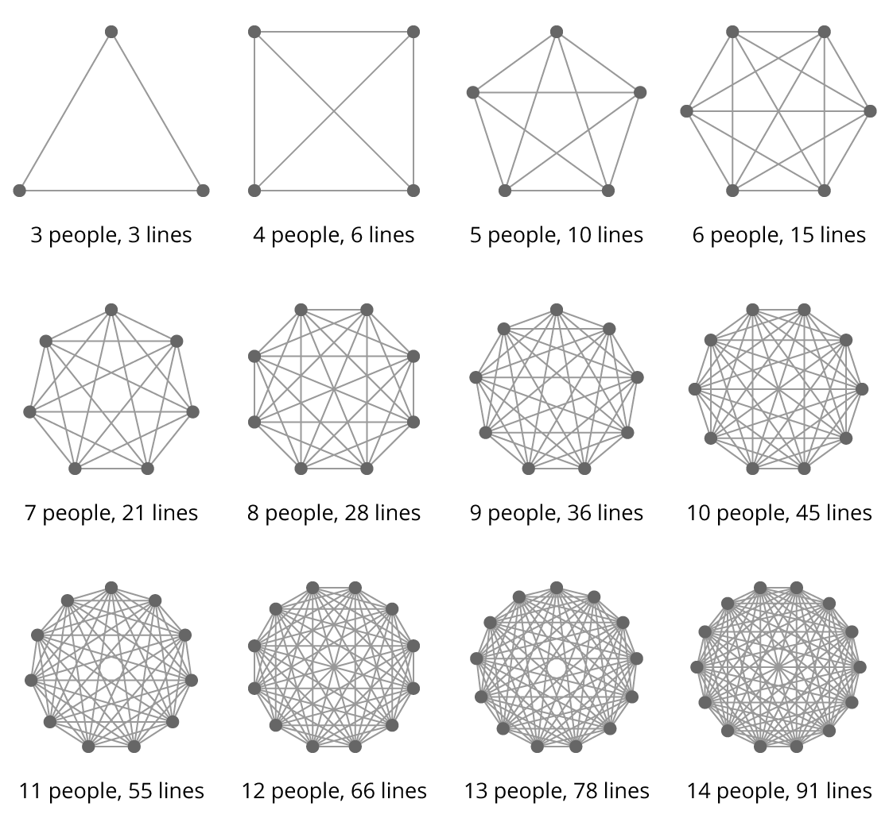
Decentralized Cooperation
Scalability problem
Requires handshaking and arbitration
What is necessary for optimal cooperation?

Slide 58
Centralized Cooperation
Agent assignment
Get list of agents
Assign each agent a task
Task assignment (Rabin’s made-up term)
Compose list of tasks
Prioritize
Assign tasks to best candidate

Slide 59
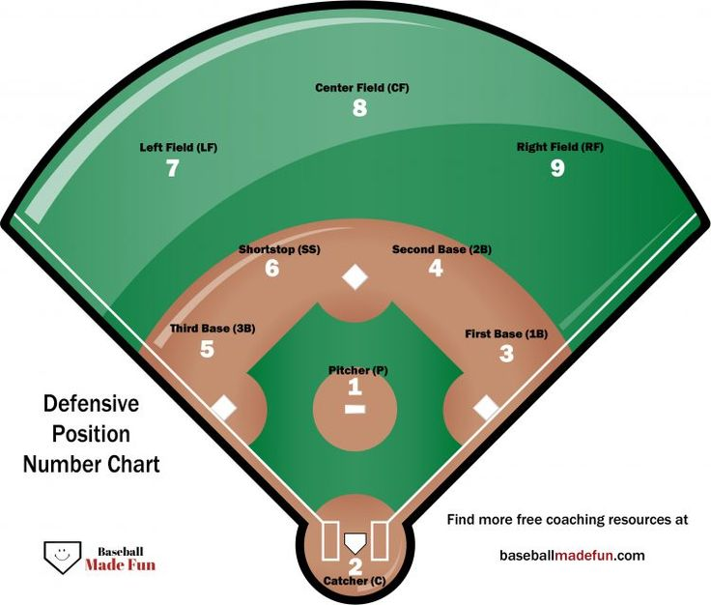
Tasks:
Get ball
Backup ball
Cover 1st
Cover 2nd
Cover 3rd
Cover Home Plate

Slide 60
Centralized Cooperation
Playbook cooperation
Preplanned assignments based on situation
Exhaustive analysis
Some permutation of tasks/agents is optimal
Score and pick best

Slide 61
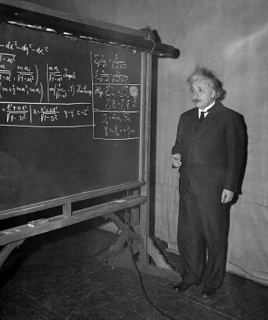
Blackboard Cooperation
Complex problem is posted on a shared communication space
Agents propose solutions
Solutions scored and selected
Continues until problem is solved
Alternatively, use concept to facilitate communication and cooperation

Slide 62
Units Compete for Missions

Slide 63
F.E.A.R. Blackboard for Pathfinding

